Slide 1
Adaptive Traffic Control System for Emergency Vehicles
Intelligent Traffic Management

Slide 2
INTRODUCTION
Imagine you're driving on a road with multiple lanes, and each lane has its own traffic light. Sometimes, you might notice that one lane has a lot of traffic while another lane has very few cars.
This can cause delays and make your trip longer.Now, imagine if the traffic lights could "see" how many cars are in each lane and change the timing of the lights to help the traffic flow better.
That's what we want to achieve with our system.We'll use cameras placed at intersections to capture images of each lane. Then, we'll use a technology called YOLO, which is really good at recognizing objects in images, to count the number of cars in each lane.
Based on this information, our system will decide how long each traffic light should stay green or red. For example, if one lane has a lot of cars and another lane has few cars, the system might make the light stay green longer for the lane with more cars to help those cars move faster.
In simple terms, we're using cameras and smart technology to help the traffic lights make better decisions and keep traffic flowing smoothly.

Slide 3
INTRODUCTION
The objective of Adaptive Traffic Control Systems (ATCS) is to optimize the management and operation of traffic signal control in order to improve traffic flow, enhance safety, and increase overall transportation efficiency
ATCS aims to leverage technology, data, and adaptive control algorithms to improve the efficiency, safety, and sustainability of traffic signal operations. By continuously monitoring and adapting to traffic conditions, ATCS aims to provide a better transportation experience for road users and contribute to more efficient and livable cities.
Key Features and Functionality:
Reduce Traffic Congestion
Providing best Traffic Signal Optimization
Report of any accident occurs
Emergency vehicle prioritization

Slide 4
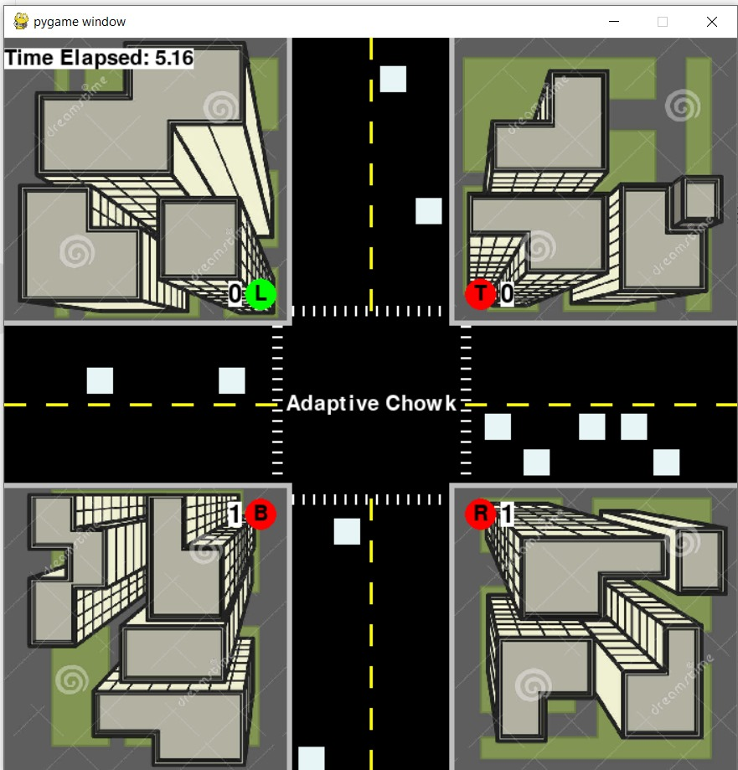
SIMULATION

Slide 5
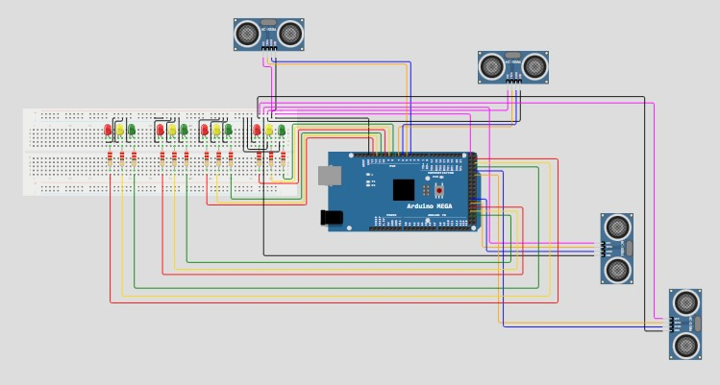
IOT

Slide 6
DONE BY TEAM NAME - Smart Route Squad SIVA TEJA– 21MIC7137 VASUDHA – 21MIS7121 YAGNA SRIYA – 21MIC7185

